Slide 1
TOPIC 10.2
ARENES

Slide 2
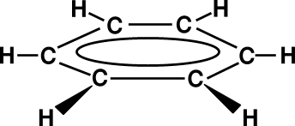
INTRODUCTION
Arenes = aromatic hydrocarbons
General formula = C_{n}H_{2n-6} (n≥6)
Benzene, C₆H₆ = the simplest & most important arene.
Benzene molecule is planar, symmetrical and
non- polar.

Slide 3
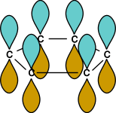
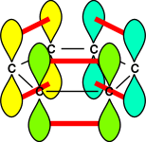
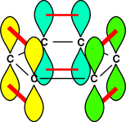
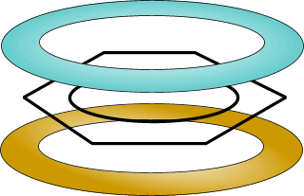
INTRODUCTION
The π electrons are delocalised around the ring. They do not belong to any particular carbon atoms, but are distributed throughout the entire π system.
This delocalisation of π electrons makes benzene chemically different from alkenes.
Benzene are stabilised as a result of this delocalisation of π electrons.

Slide 4
CHEMICAL
REACTIONS

Slide 5
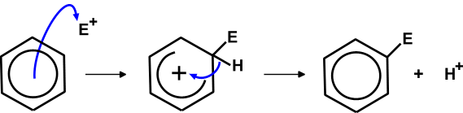
ELECTROPHILIC SUBSTITUTION
  The high electron density of the ring makes it open to attack by electrophiles
  Addition to the ring would upset the delocalised electron system
  Substitution of hydrogen atoms on the ring does not affect the delocalisation
Mechanism
• a pair of electrons leaves the delocalised system to form a bond to the electrophile
• this disrupts the stable delocalised system and forms an unstable intermediate
• to restore stability, the pair of electrons in the C-H bond moves back into the ring
• overall there is substitution of hydrogen ... ELECTROPHILIC SUBSTITUTION

Slide 6
NITRATION
Reagent : conc. HNO₃ and conc. H₂SO₄
Condition : reflux at 50 - 60ºC
Product : nitrobenzene
e.g.

Slide 7
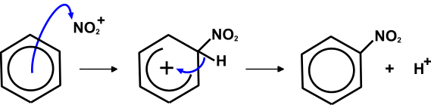
ELECTROPHILIC SUBSTITUTION MECHANISM
# Production of electrophile NO₂⁺

Slide 8
HALOGENATION
Reagent : Cl₂
Condition : at room temperature,
in presence of halogen carrier (catalyst)
[ e.g. AlCl₃, FeCl₃ , Fe]
Product : chlorobenzene
e.g.

Slide 9
METHYLBENZENE

Slide 10
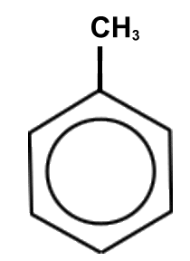
INTRODUCTION
Common name = Toulene
a methyl group attached directly to the
benzene ring
Formula = C₆H₅CH₃
Two parts of the molecule
- the alkyl side chain ~ free radical substitution
(reactions of alkanes)
- the aromatic ring ~ electrophilic substitution
(nitration & halogenation)

Slide 11
Electrophilic substitution reactions are quicker with methylbenzene than benzene.
REASON : the methyl group donates electrons into the ring making it more susceptible to electrophilic attack.
Electrophilic substitution mechanism of methylbenzene is similar to that of benzene ring.
Substitution takes place at the 2- and 4- positions on the benzene ring.

Slide 12
DETERMINATION OF THE POSITION OF A SECOND SUBSTITUENT ON BENZENE RING
The position of the second substituent is determine by the nature of the substituent (X) which already present in the ring.
If X is an electron-donating group, it activates the ring towards electrophilic substitution and is 2- , 4- & 6- directing.
e.g.
If X is an electron-withdrawing group, it deactivates the ring towards electrophilic substitution and is 3- & 5- directing.
e.g.
Exception : Halogen atoms are electron-withdrawing
but are 2- , 4- & 6- directing.

Slide 13
NITRATION
Reagent : conc. HNO₃ and conc. H₂SO₄
Condition : 30ºC
Product : 2-nitromethylbenzene and 4-nitromethylbenzene
[ Electrophilic substitution ~ as with benzene]

Slide 14
HALOGENATION
With methylbenzene, halogenation can occur in the aromatic nucleus or side-chain depending on reaction conditions.
1) Reagent : Cl₂
Condition : in the presence of AlCl₃ and in the dark ,
*at room temperature
Product : 2-chloro and 4-chloro methylbenzene
and HCl
[ Elctrophilic substitution in the aromatic nuclues ]

Slide 15
HALOGENATION
2) Reagent : Cl₂
Condition : in the presence of uv or sunlight
[ Free radical substitution in the side chain]

Slide 16
OXIDATION OF SIDE CHAIN
Reagent : KMnO₄ in H₂SO₄(aq)
Condition : reflux
Product : Benzoic acid (white precipitate)
* Observations

